Slide 1
Bonsuck Koo
New Graduate Rotation Program– Guidance, Navigation & Control

Slide 2

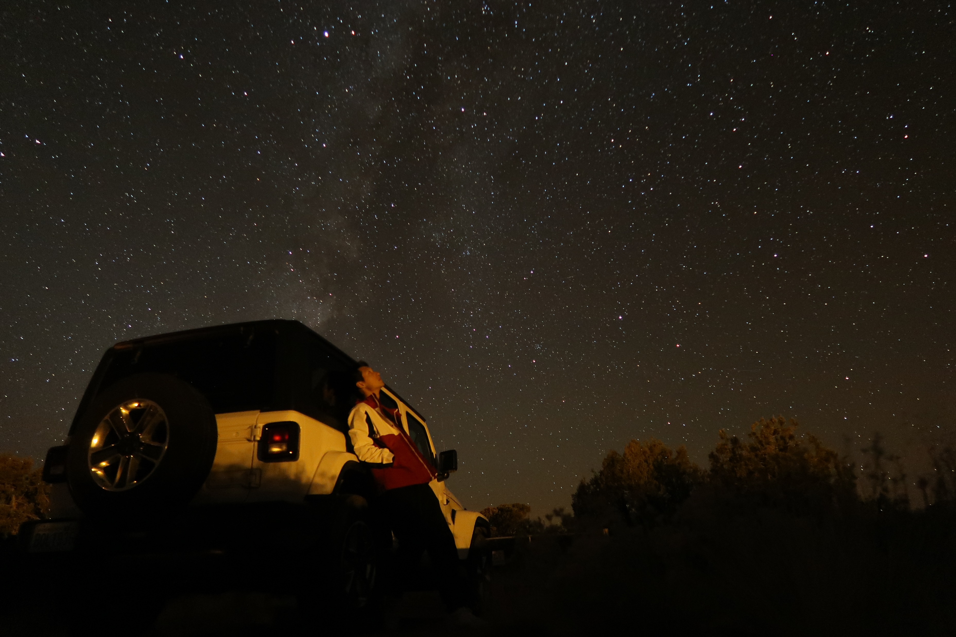
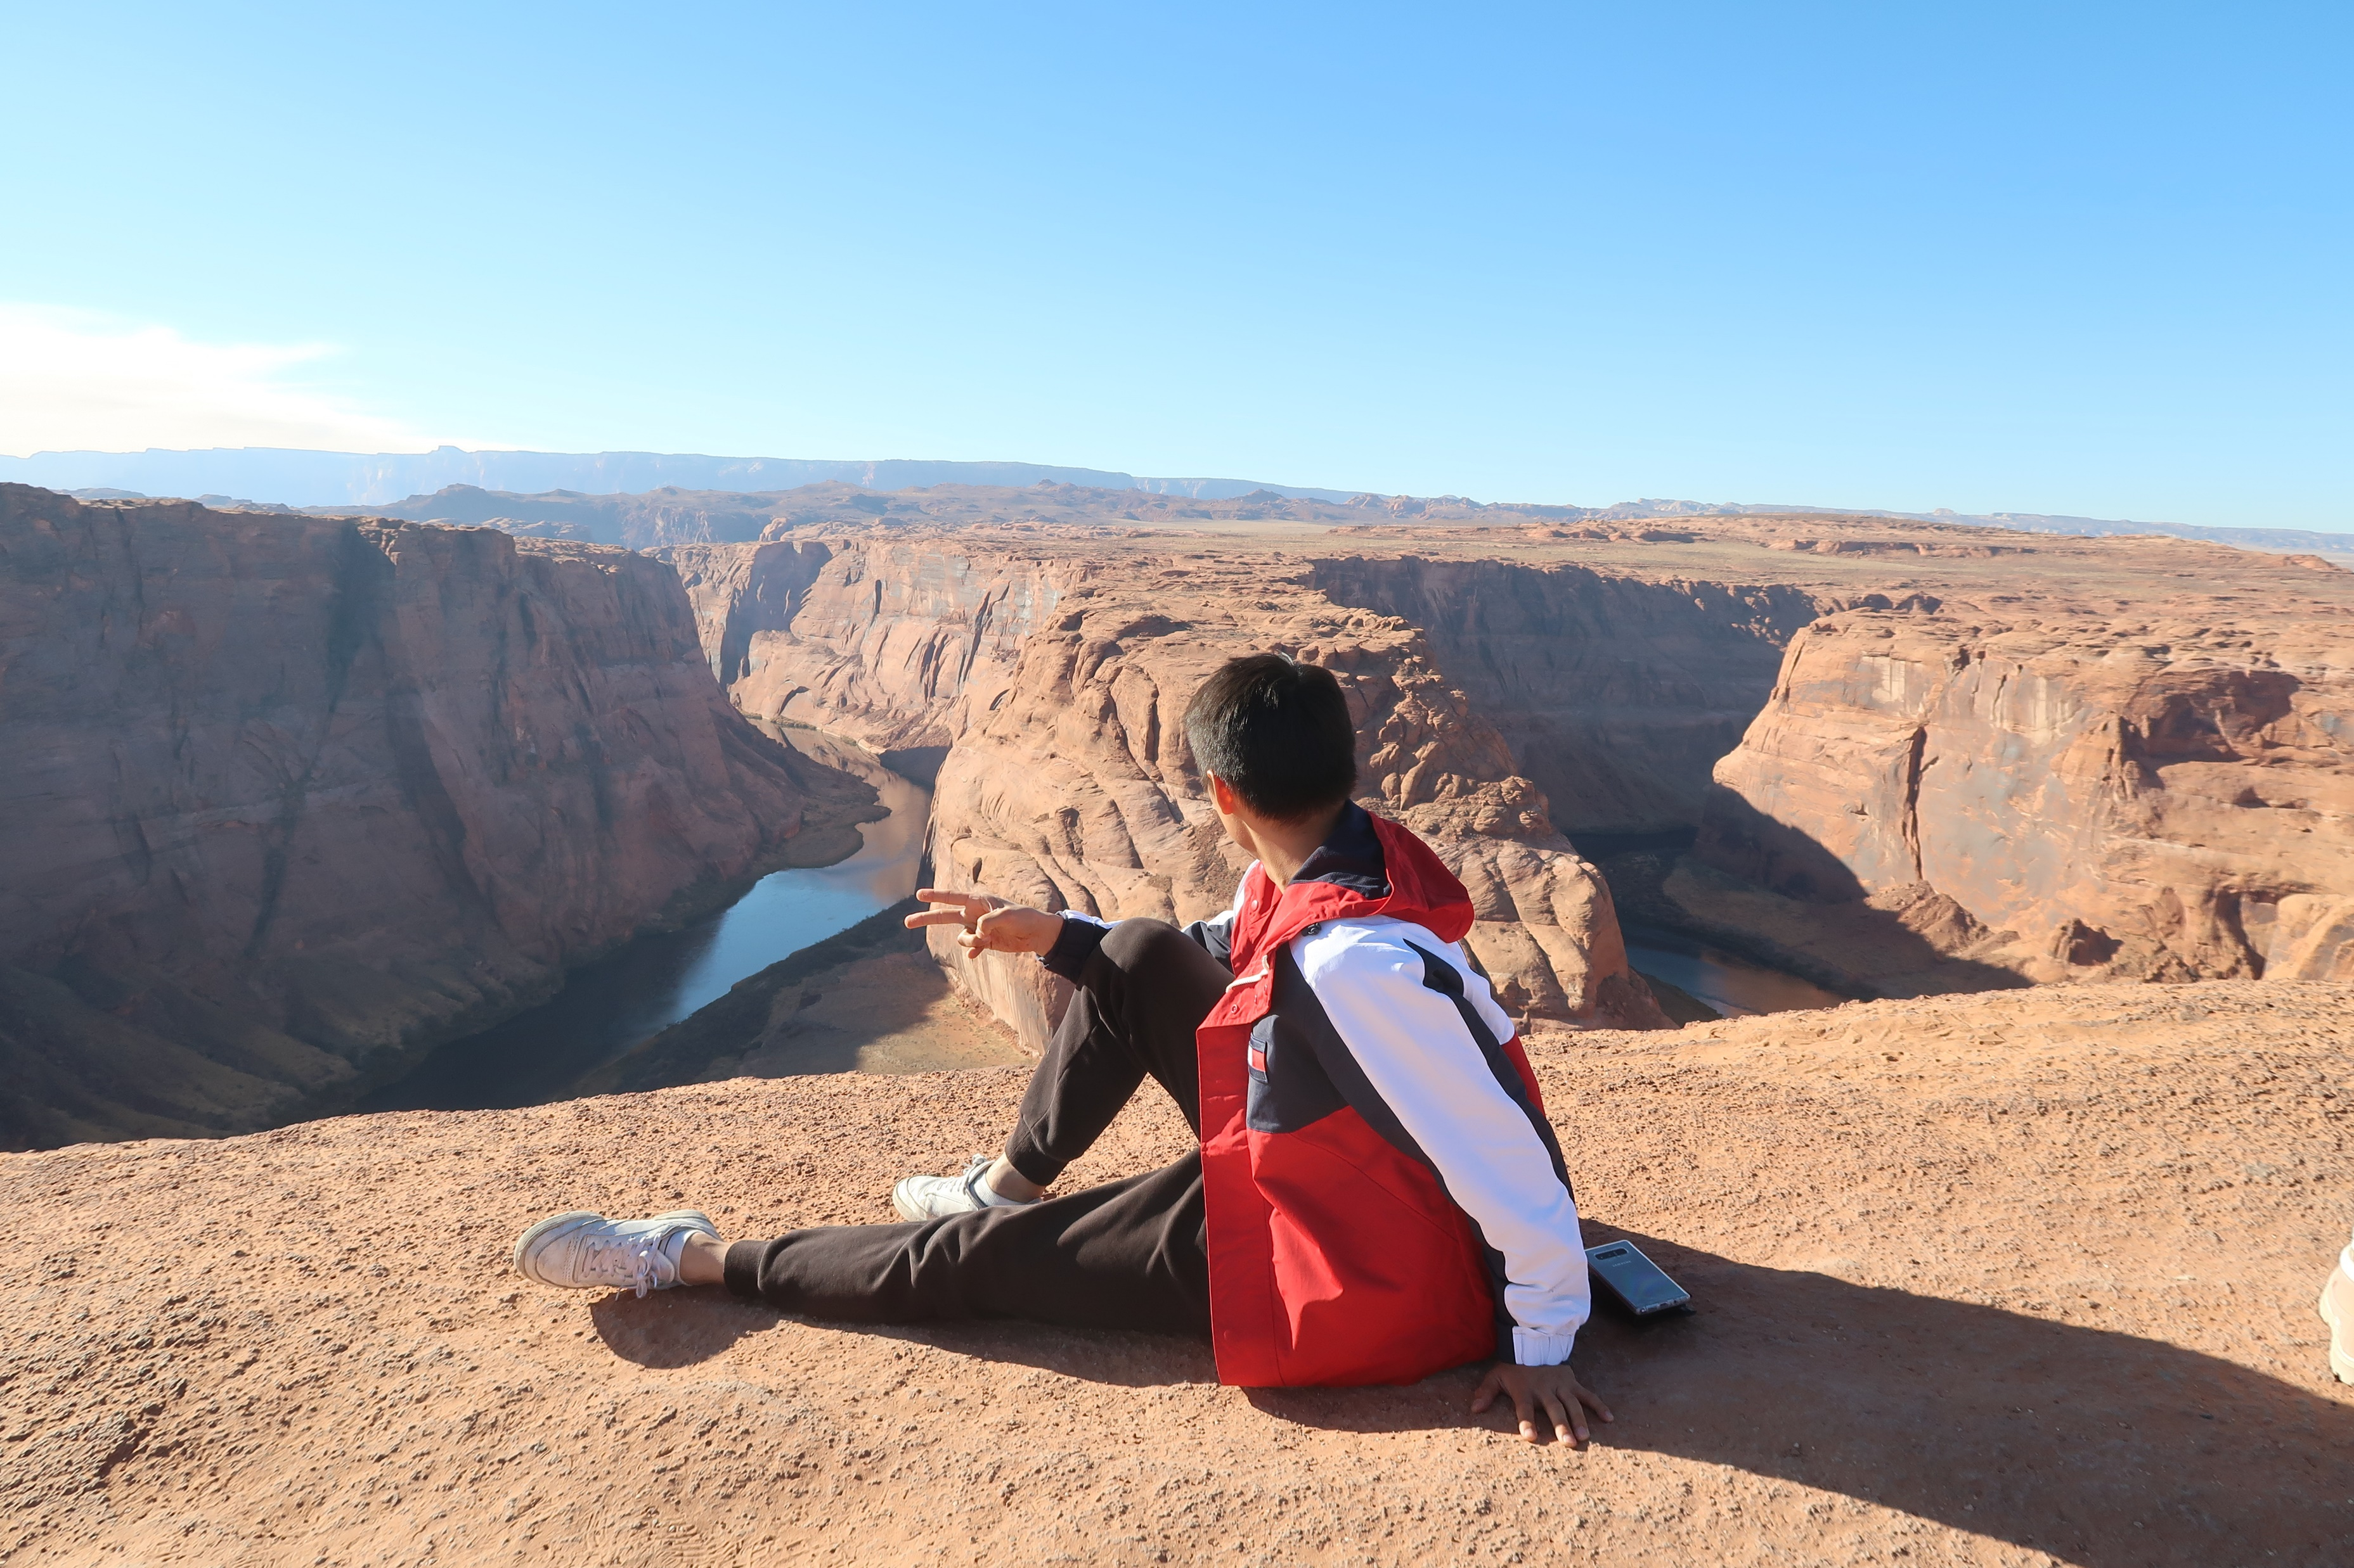
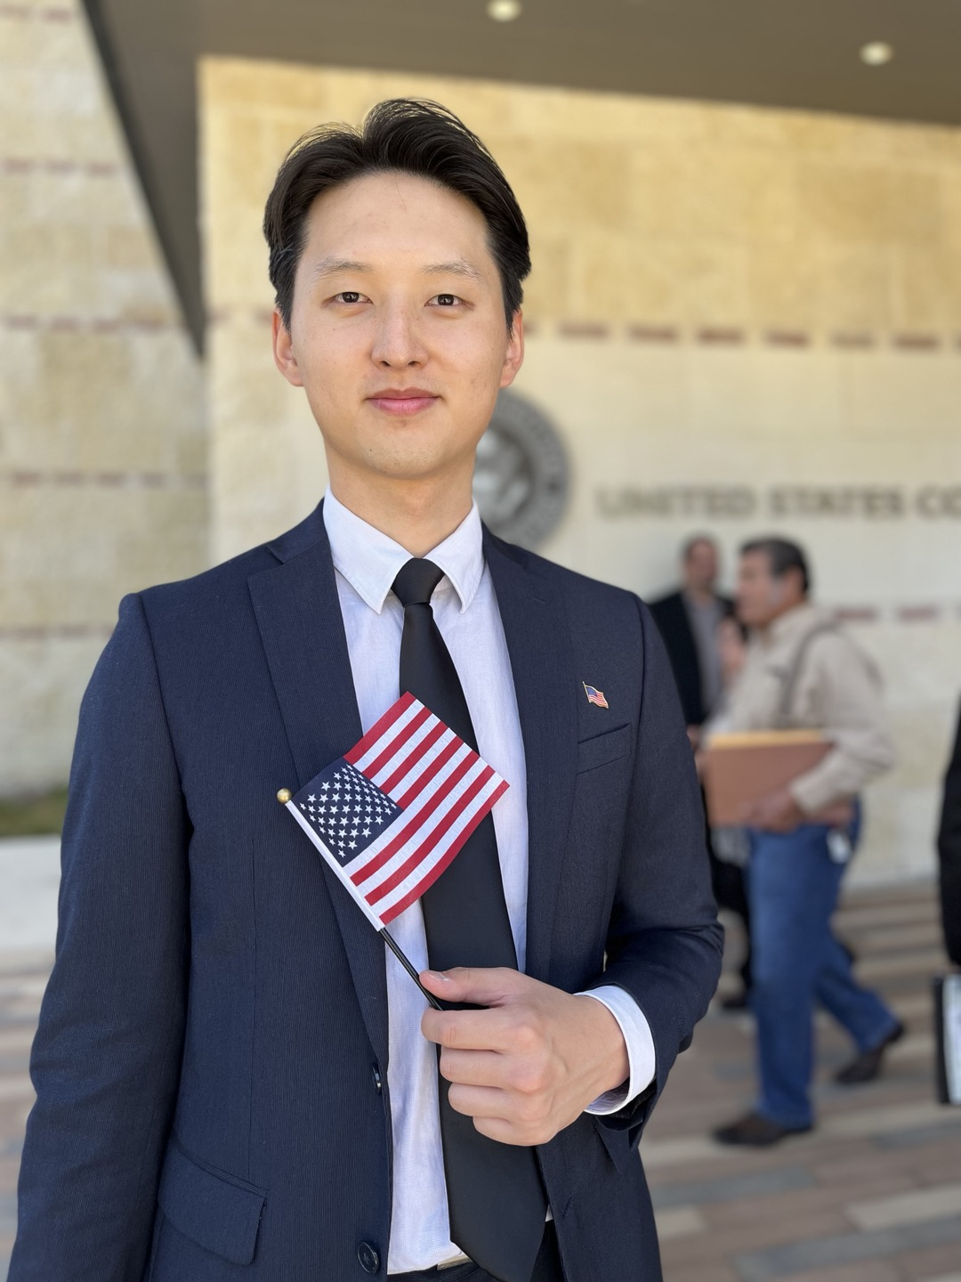
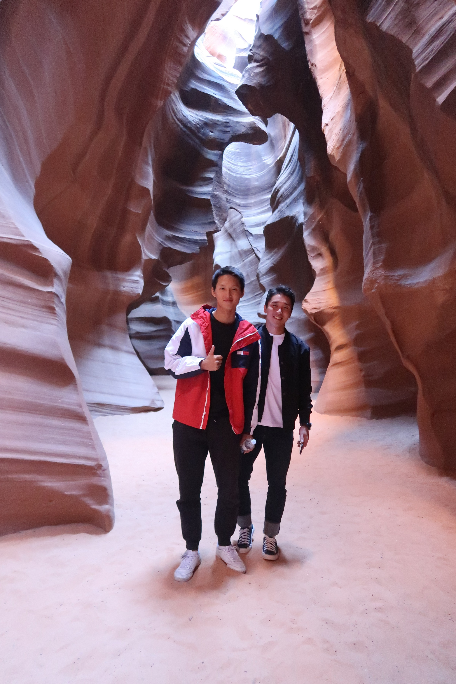
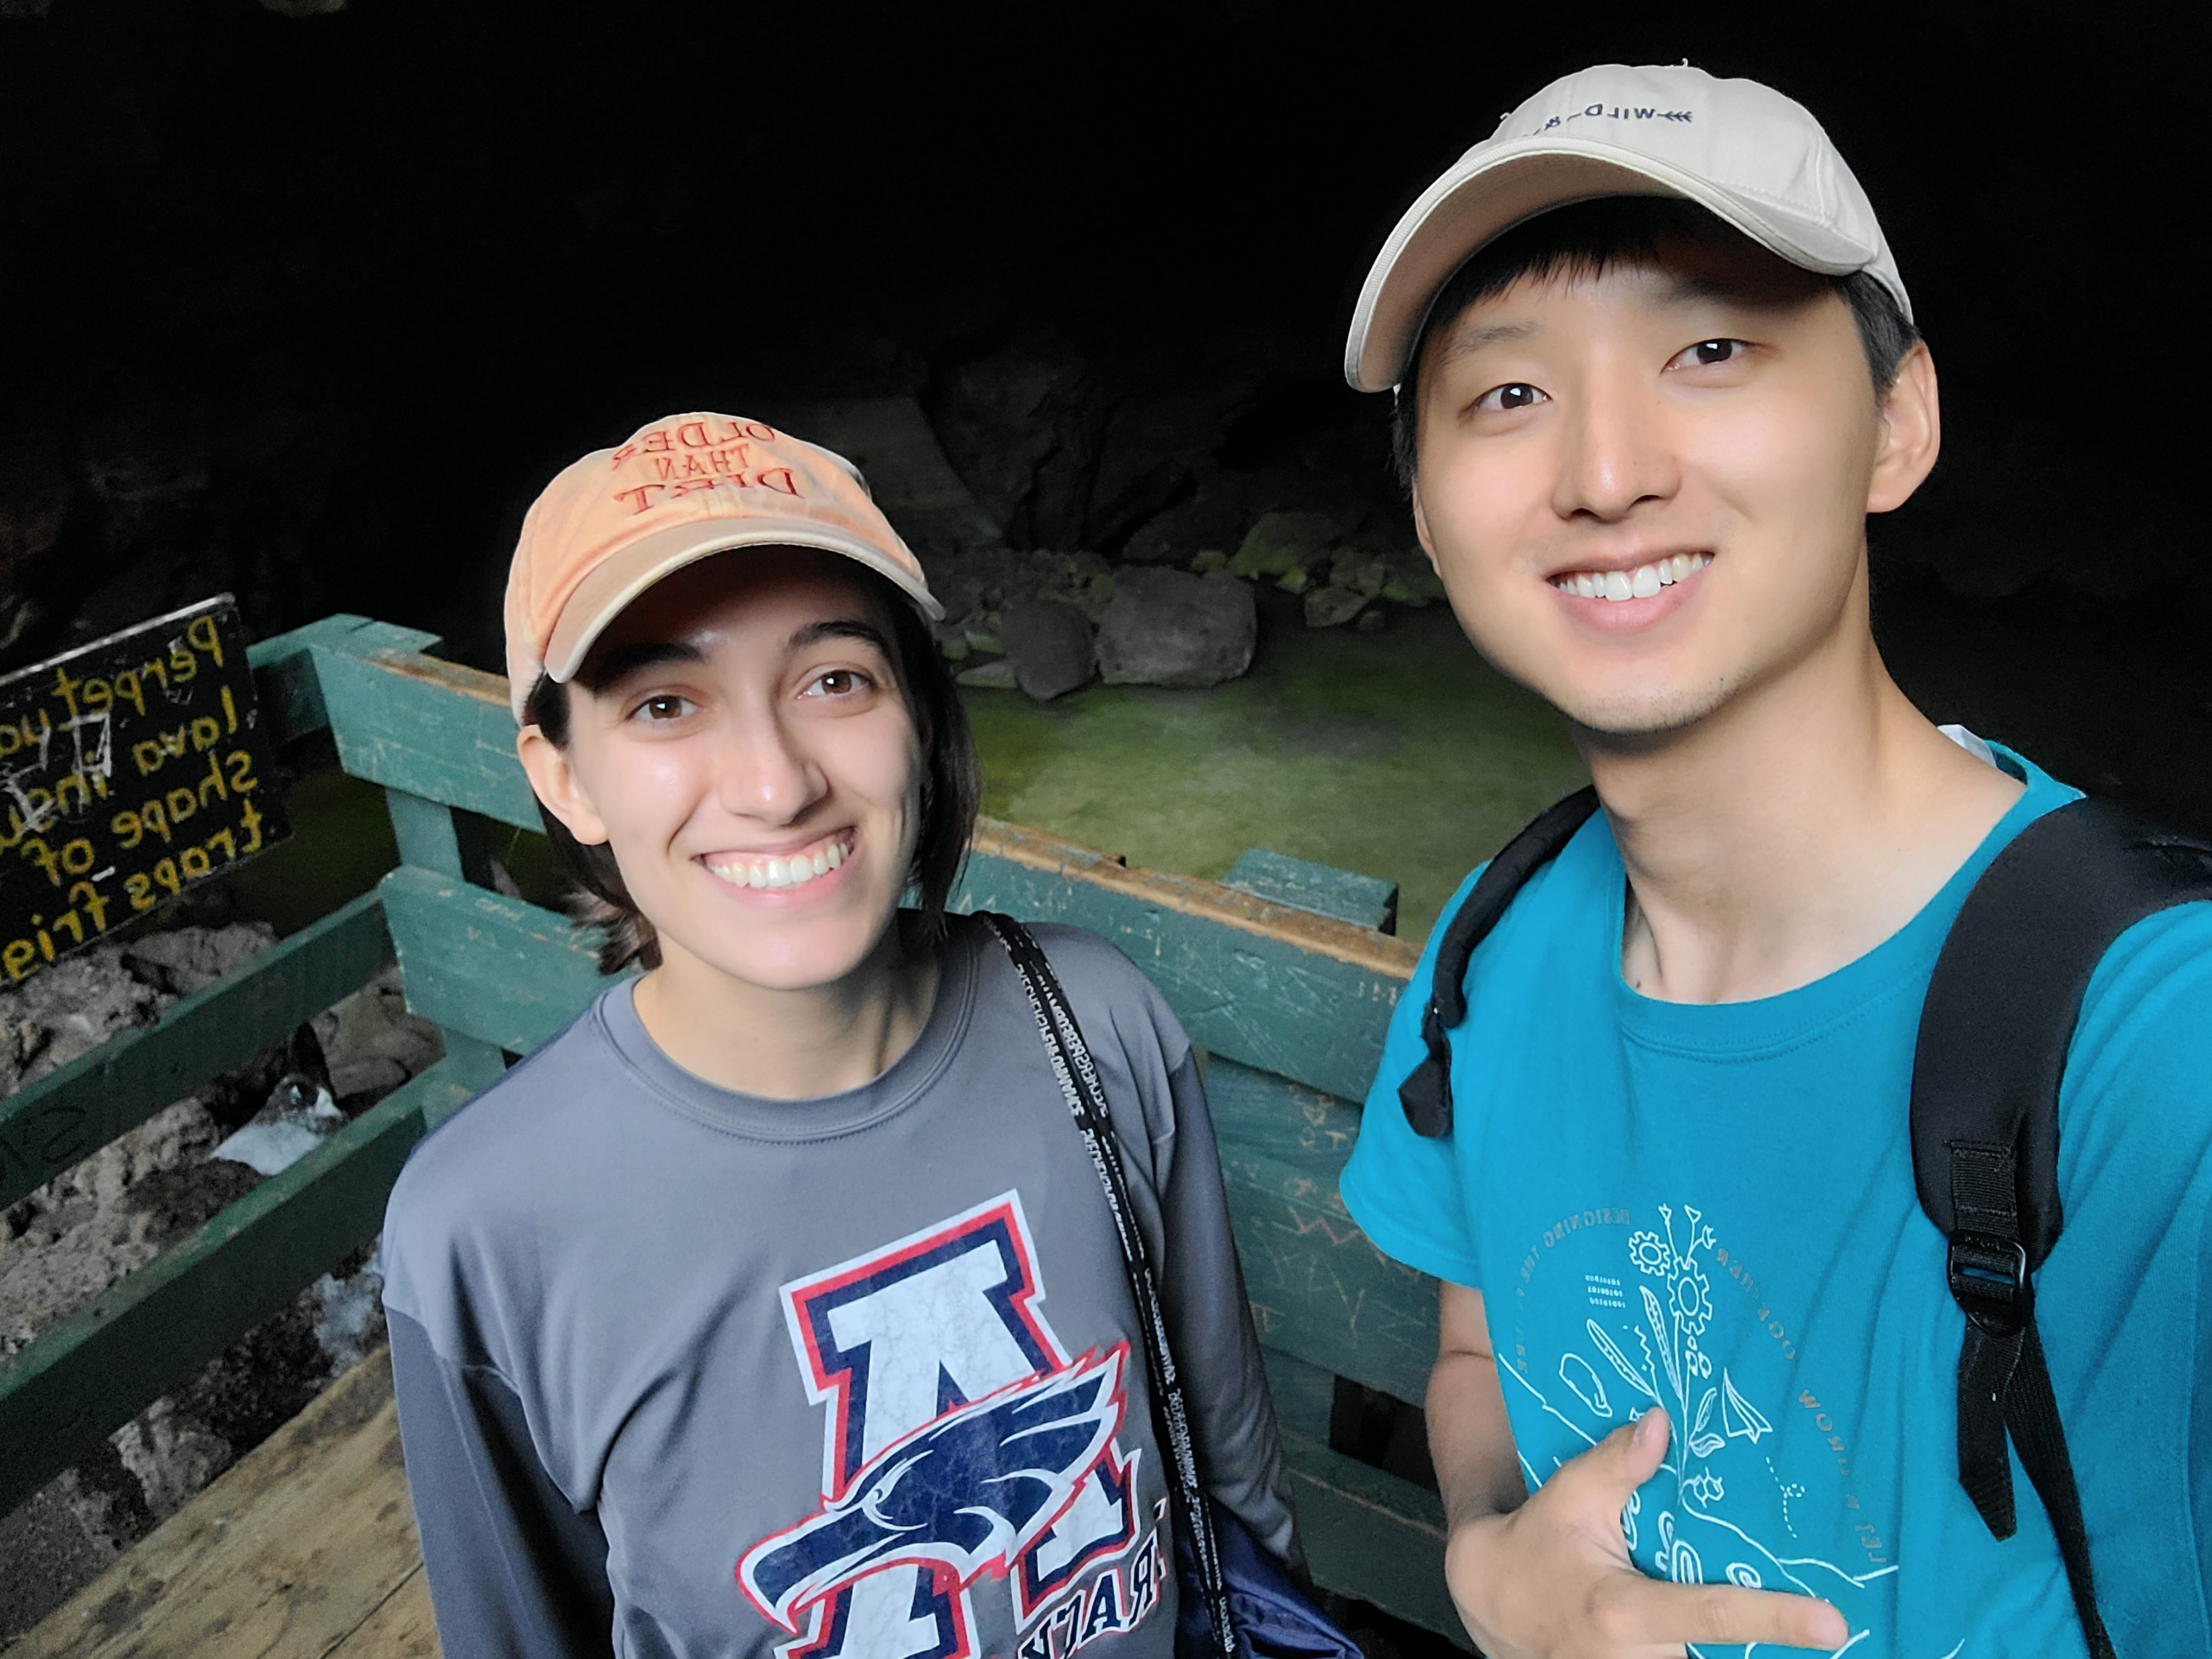
Introduction
Name: Bonsuck Koo
School: University of Texas at Austin
Degree: Integrated Master and Bachelor of Science in Mechanical Engineering (2024 Dec.)
Hobbies: Visiting National Parks
Obtained American Citizenship in July 2023
Notes:
MY name is Bonsuck Koo. And I am here to interview for the GNC engineer (early career) position. I am going to do my best to present myself to you guys.
I am a student at the university of Texas at Austin. And I have one semester left until I get my degree in Integrated Masters and Bachnelors of science in Mechanical Engineering. Lately, my hobbies have been visiting national parks or go on a hike on a weekend. I have gone to Grand canyon, Glen canyon for horse shoe bend, antelop canyon. And recently I have been trying to go everyweekend in New Mexico. The most amazing I have seen so far this summer was White sands national park. Just watching the beauty and scales of things in nature, it leaves me in awe and humbles me, so I like to look at them and visit them. I hope MAYbe one day I could see the Earth from space too, that would be the best thing I could see in my life I think.
I didn’t have a car and was biking in Seattle while I was there last year some of you might remember. So I didn’t get to go as much as hikes in Washington as I wished, but If I today goes well, I hope to visit a lot of places in Washington and get recommendations from you guys.
Also I obtained my American Citizenship in July 2023, I want to thank my parents for all that, so I could work in the Space industry without much restriction!

Slide 3
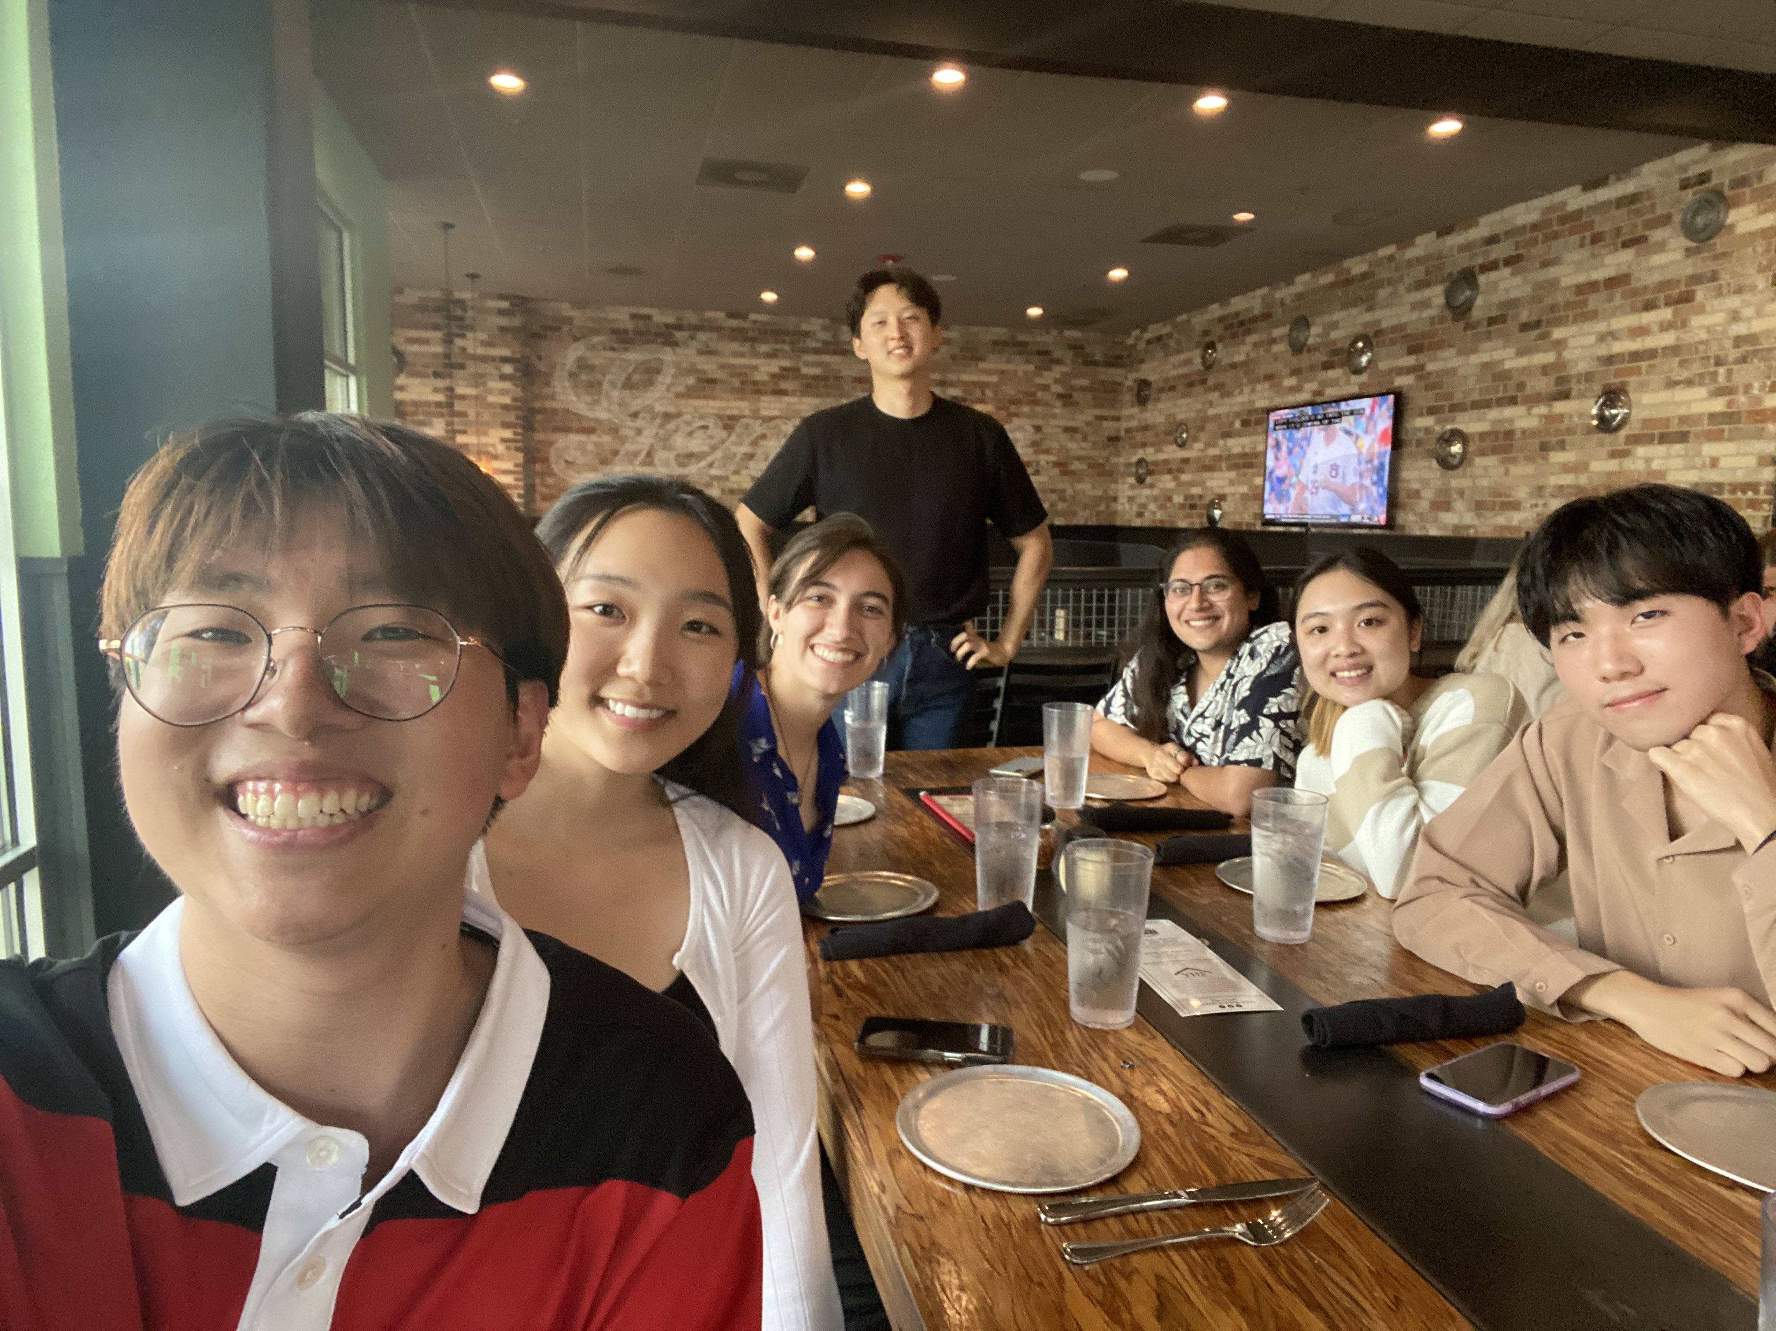
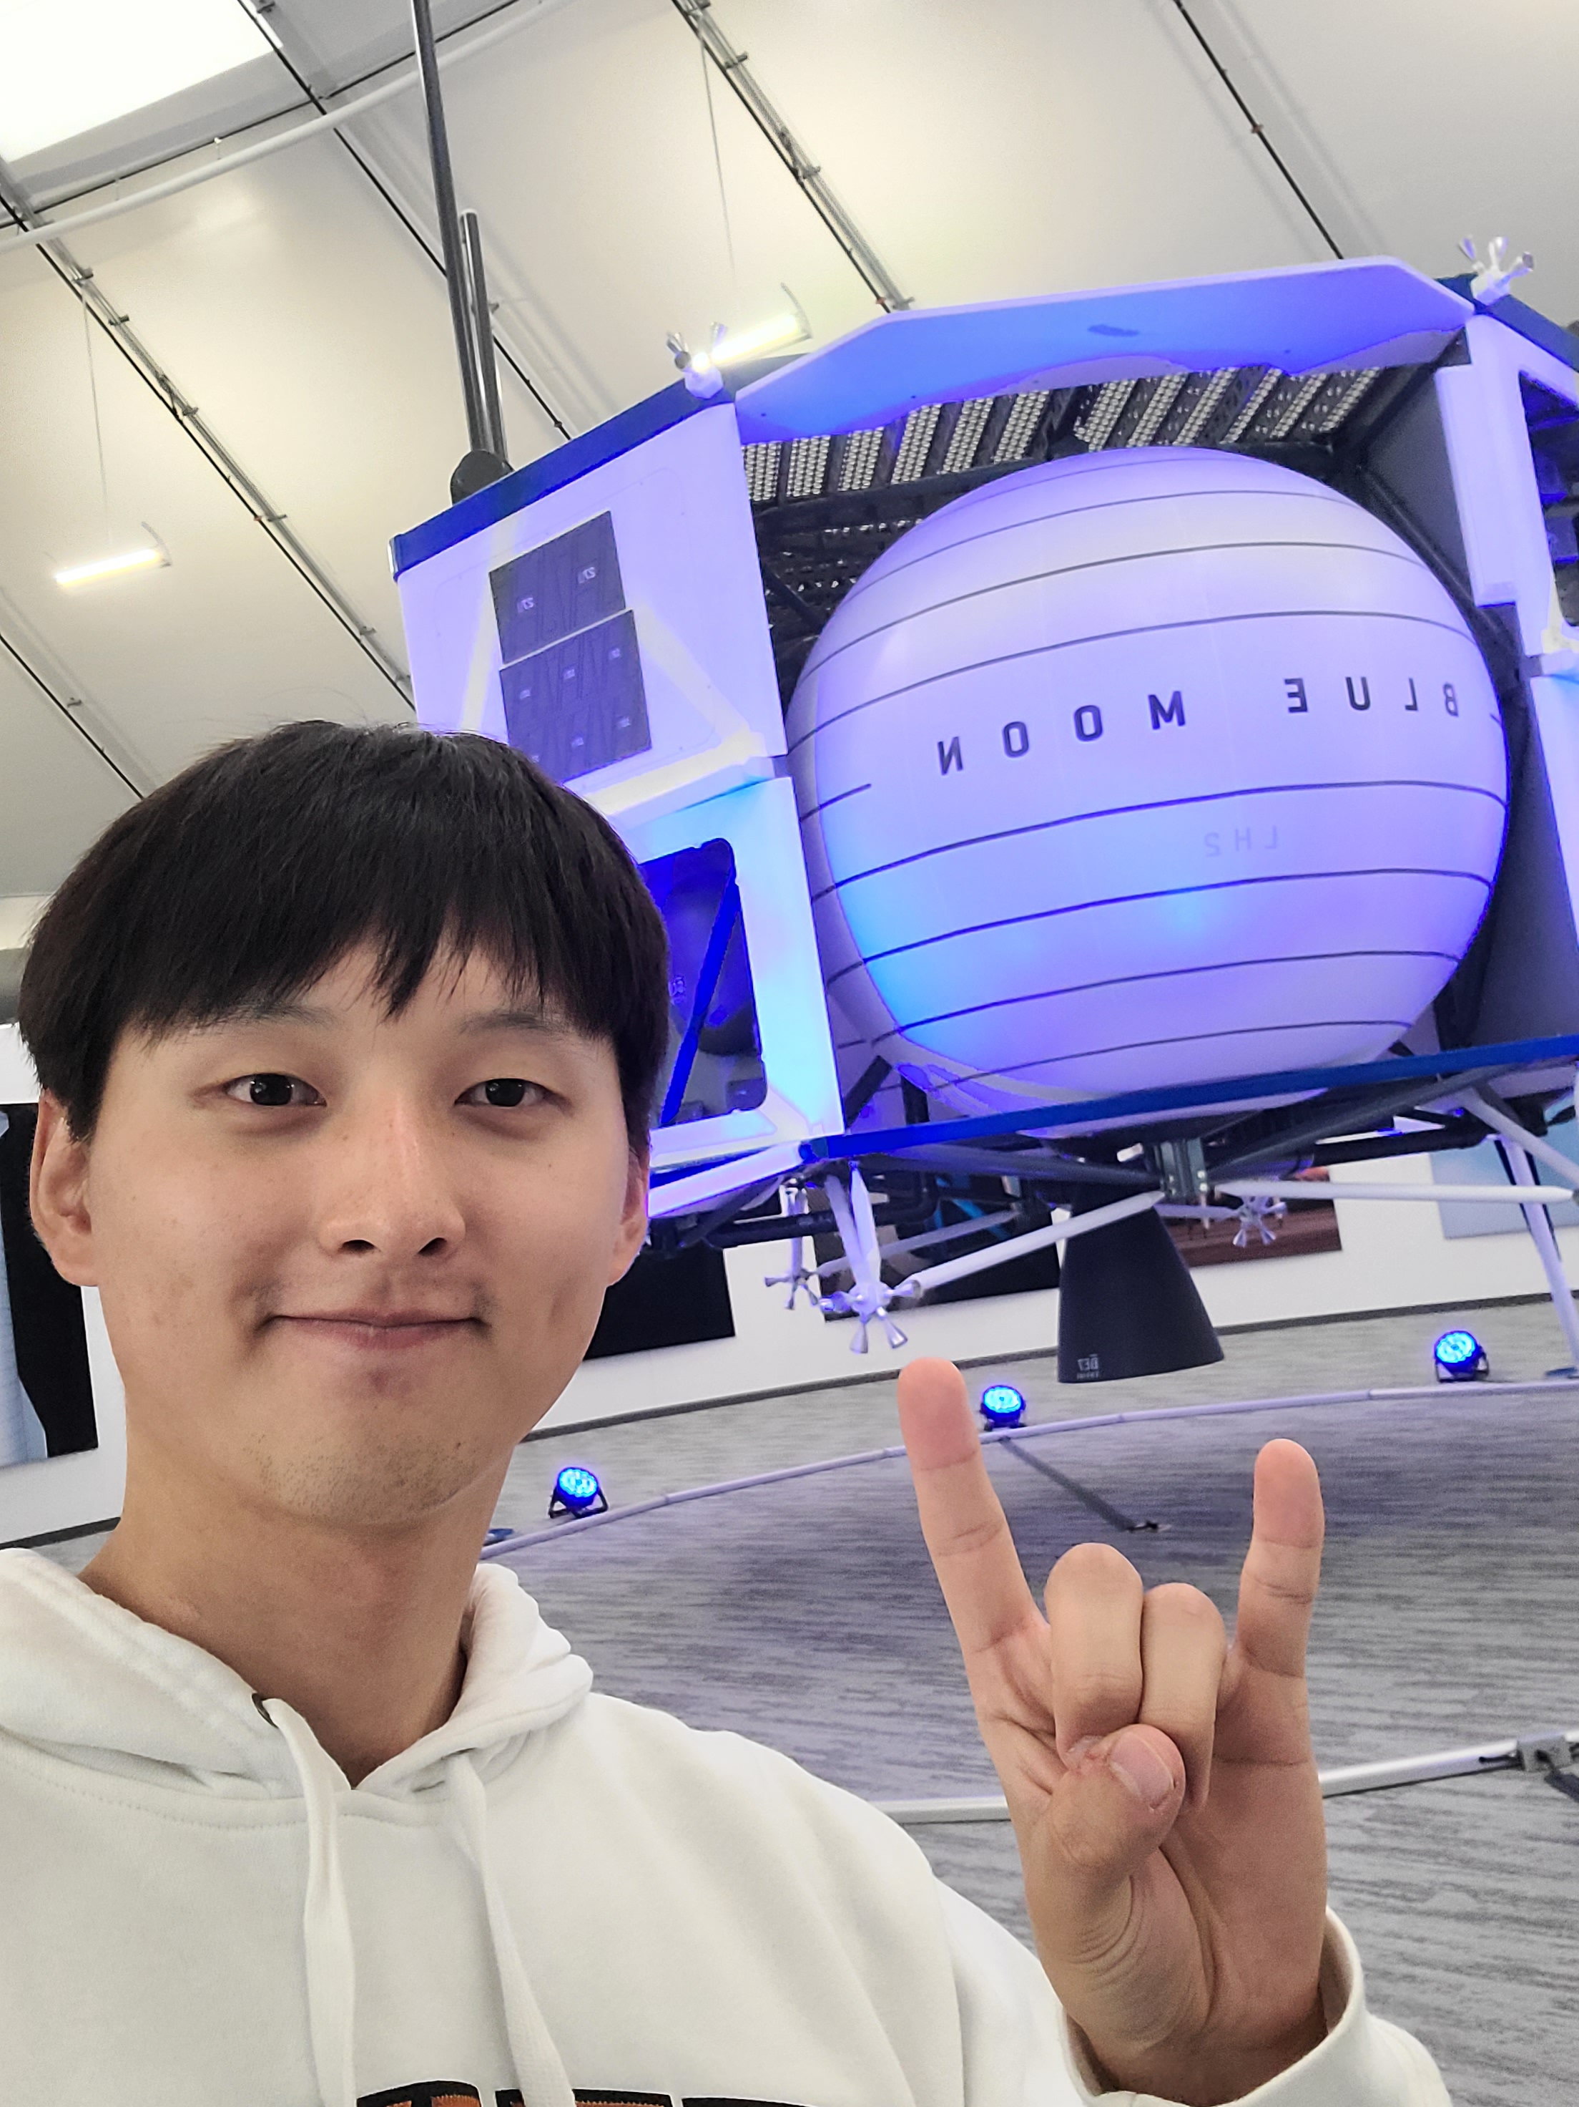
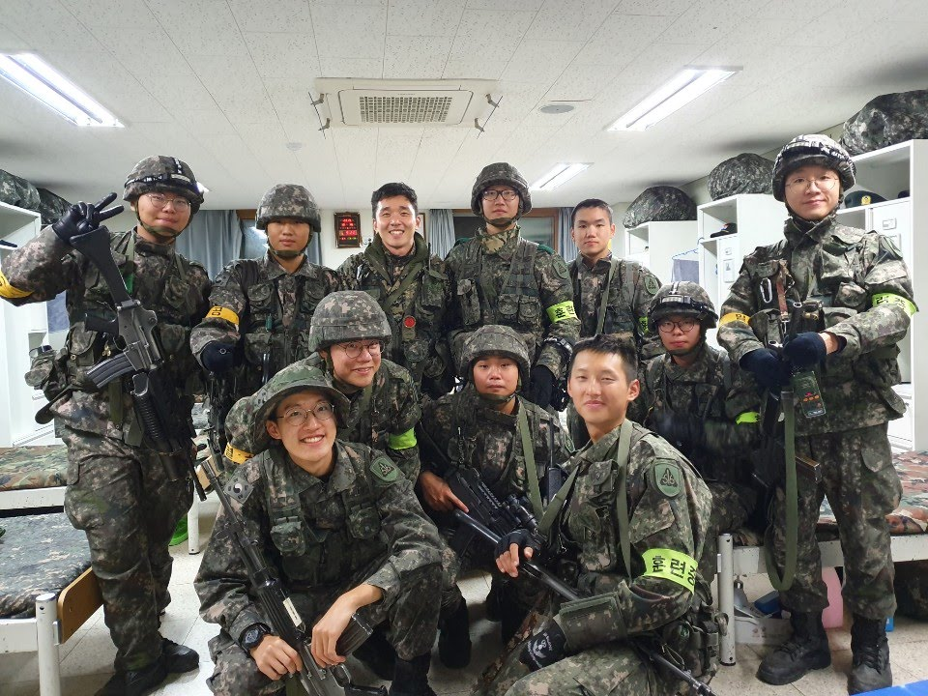
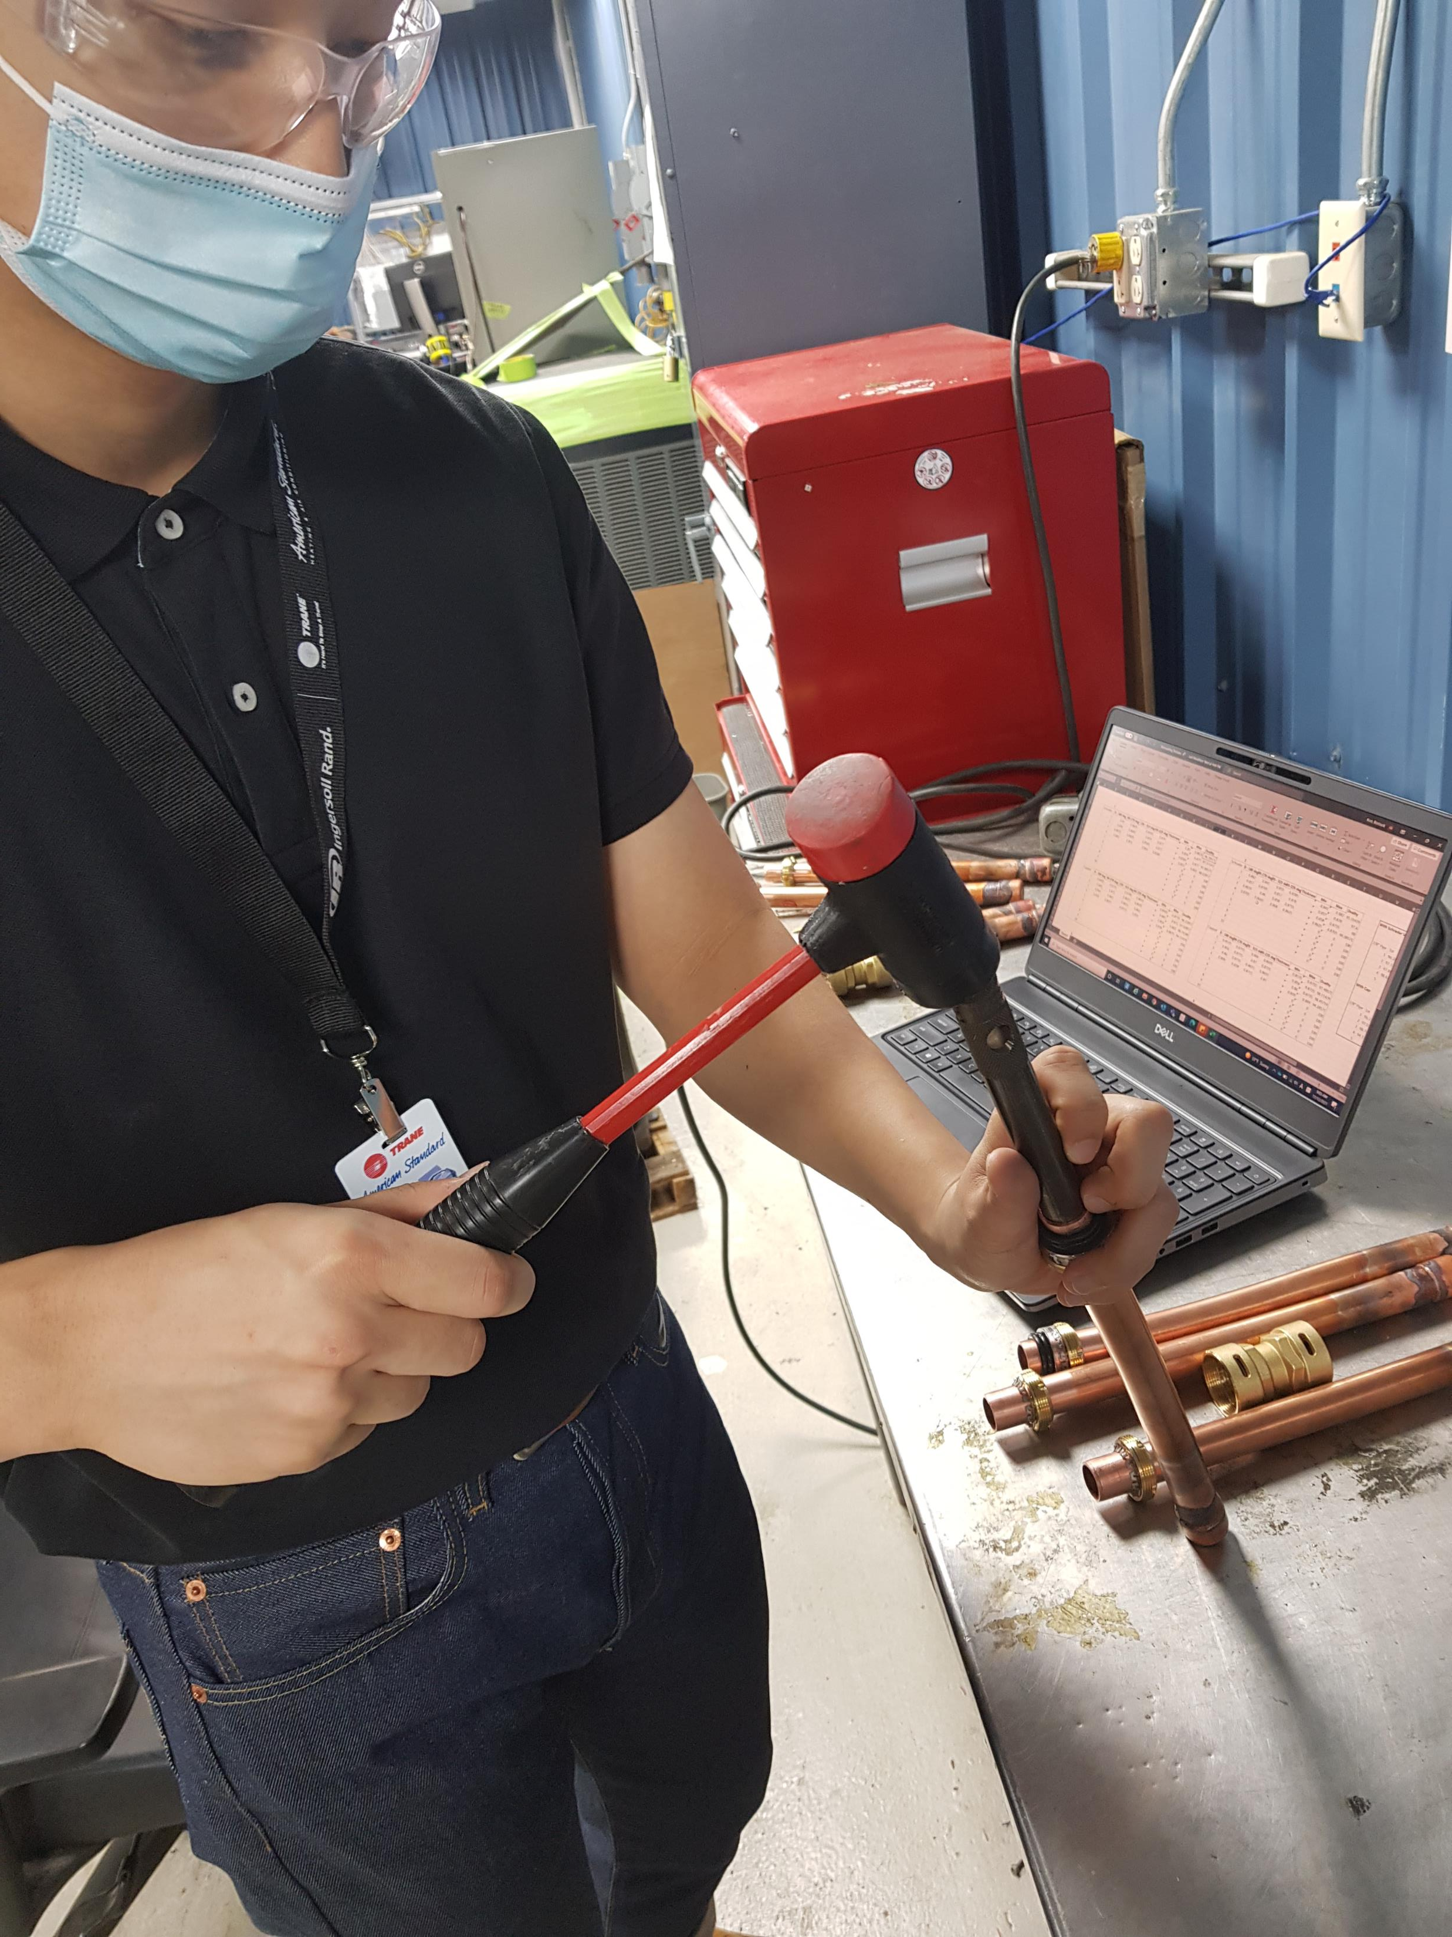
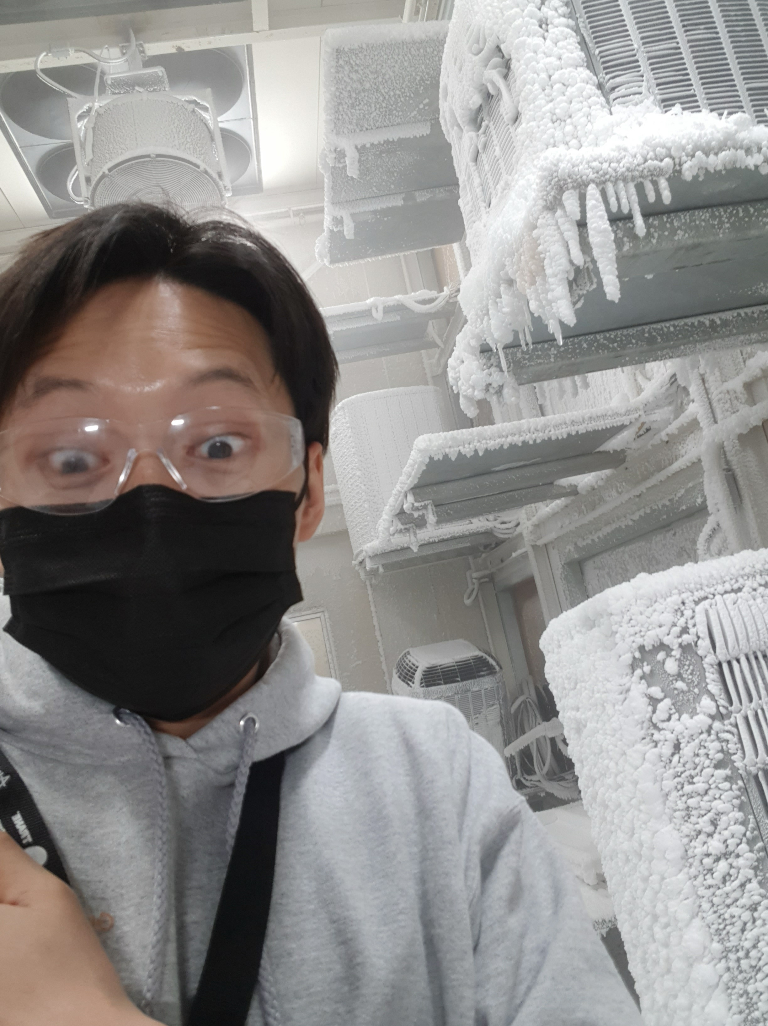
Experience overview
NGC engineering intern
Sandia National Laboratories (Current)
GNC engineering Intern
Blue Origin (2023 Fall)
Mechanical Engineering Intern
Samsung Austin Semiconductors (2022 Summer)
System Engineering Intern
Trane Technologies (2021 Summer and Fall)
Mandatory Korean Military service (2018-2020)
Notes:
I am currently working as NGC or GNC eningeering summer intern at Sandia National Laboratories. I am doing almost exactly the same thing I had done at Blue, which was working with MATLAB and Simulkink Simulation of a flight vehicle.
Before that I worked at Blue as a GNC engineering intern in the New Shepard team in 2023 Fall as you guys know. There is a picture of me infornt of the moon lander.
In 2022 Summer, I worked at Samsung Austin Semiconductors, working on projects to facilitate technician’s work process. Although I was hired as a mechanical engineering intern, I was given a computer science task. I have never created a website before, I had no experience with JAVA, HTML, CSS, and SQL. But I learned in for two months during internship, and at the end I was able to create a website and excel VBA tool for the tehcnicians that saved 1 hour for the tehcnicans every shift. Although this experience here doesn’t directly match with the requirements for GNC engineering, but I like to at least briefly mention this internship because it displays my grit. Despite being thrown into a completely unexpected work and something I had no experience in, I appreciated that I got a chance to learn these new languages and did my best to produce a product. And I did deliver something for the team at the end. I am proud of that and I think it also aligns with one of the Blue’s leadership principle: “Deliver Results” ,which states that leaders show grit despite adversaries and barriers to deliver a quality result in time. That one is a picture at a lunch with interns friends at Samsung
And before Samsung my first internship was at Trane Technologies, an HVAC company, and I worked to improve technician’s work process there as well. I was working with copper pipes and trying to qualify a new component for AC and heating installation machines like the picture you see there. The last picture is a weather control room at Trane. Tha t room goes through four seasons in such a short amount of time. I think it goes through the cycle in only about two weeks. It snows, gets hot and rains to emulate the weather conditions outside, my component was getting tested in that room so I went in to go check I thought that was really cool so I put that picture.
Lastly, I did a mandatory military service in Korea from 2018 to 2020 when I still had the Korean citizenship, I just wanted put that there to explain my gap in education during those years.

Slide 4



Why Blue Origin?
Notes:
I want to join Blue because it shares my professional goa, which is to benefit our entire society. In my previous internships, the magnitude of impact that I realized an engineer could have and the apperication I received for helping technicians was so rewarding that I wanted to seek bigger work that benefit a greater society. I believe the best way to do so for me is by facilitating space travel. Because of global warming, I sincerely believe we have to reach out to space to find new resoiurces and new habitat. Also, I love nature, I like seeing them as I said before. I want all my families to see it, my friends to see it, and all the future generation to see what I saw. I don’t want Earth to change, I want to conserve it. Putting my effort into it wil help everyone in the world.
That’s exactly the mission Blue Origin has. Blue distinghishes itself from all the other space companies in that aspect. It emphasizes the bnefit of Earth rather than pure exicitement of spce exploration.
And As one of the Blue’s leadership principle, which is “Passion for our Mission”, as that principle explains, it is the Mission or the goal in our career or life, that motivates and drives people to put efforts to and produce results., so I think it’s important for both the company and myself to have that common goal to produce anything meaningful.
And I can contribute to that effort with my knowledge in GNC engineering. My master’s emphasis is in constorls and aerospace, and my courses and internship experiences has been geared towards it.
In addition, I understand Blue has a very supportive environment. While I was there last year, my mentor Phil, was always hands on and guiding me through my project. I learned a lot from him regarding using MALTAB simuloink especially GIT, Also with Tony he was always responsive to any questions I had, I felt comfortable asking him to do a 1on1s and ask for any guidance. Of course I think Jeff and Ethan in office created a very comfortable and fun environment in office, and also they were always open to me asking questions and having 1 on1s. I really like that supportive environment. Besides that the people in HR, Sara Ralaeigh and Chad here were all helpful and sometimes I felt they were truly tring to help me advance in my career.
I wante to be part of all that again and I hope today’s presentation could qualify me for it.

